Slide 1
Module 2: Introduction to public reviewing roles and skills
Learning outcomes
Define what a review is.
Recognise what public reviewing roles there are in the research project life cycle.
Identify the different research documents including a research or commissioning brief, a research proposal, a protocol and a funding application.
Start working with complex research documents.
Provide constructive feedback.
Review your meeting and interview skills which are useful for advisory committee meetings.

Slide 2
Module 2: Introduction to public reviewing roles and skills
1 What is a review?
2 Our public reviewing roles
3 Reviewing research documents and providing feedback
4 Meeting and interview skills

Slide 3
1 What is a review?

Slide 4
1 What is a review?
Reviews are an important part of how research funding decisions are made. They can:
support those who fund research and ethics committees when they are making decisions;
give funding applicants (researchers) feedback, including an assessment of the strengths and weaknesses of their research plans; and
make sure that the proposed research is needed or important.

Slide 5
2 Our public reviewing roles

Slide 6
2.1 Public reviewing roles with the NIHR
There are two main ways in which you could be asked to carry out a review as a public contributor.
As a public reviewer of a research brief, proposal or application (usually carried out at home). We will describe these documents shortly.
As a public member of a funding advisory committee. You will review a group of research applications before going to a meeting. At the meeting you will discuss the applications and decide which will be funded.
As a public reviewer, you are usually matched to a research topic in an area where you have personal experience.
As a public member of a funding advisory committee, you will review applications on a number of different topics, not just areas where you have personal experience.

Slide 7
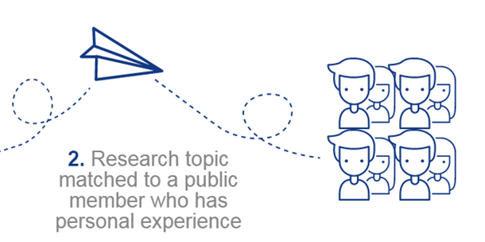
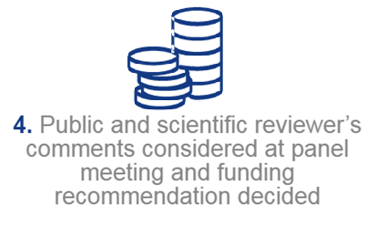
2.2 Public reviewing of a research document
2. We match the research topic of the document to a member of the public who has personal experience as a patient, carer or user of services.
1. We receive a document proposing a research study (a brief, a proposal or a funding application).
3. The member of the public reads and reviews the application’s strengths and weaknesses.
4. We send public and scientific reviewers’ comments to a research advisory committee which makes funding decisions.

Slide 8
2.3 Reviewing as a public funding advisory committee member
There are usually two or three public members sitting on funding advisory committees.
All members of the committees review the applications which are to be discussed at the meeting.
Public members will consider similar issues to public reviewers.

Slide 9
2.4 Public reviewing opportunities with us
The table below describes some of the key opportunities for public reviewing. On the following page, click the four stages in the research cycle where these might fit.
What are the opportunities? | What would I be doing? | What happens to my review?
A. Public review of draft research proposal or early funding applications | Reviewing early-stage documents which are being developed before looking for funding. | It helps the researchers develop a more effective research plan and funding application.
B. Public review of research or commissioning briefs | These are short documents which describe where there is a gap or uncertainty in knowledge. They look at the existing research evidence and examine the need for more research. The questions these documents raise may go on to be advertised for researchers to submit funding applications. | Your contribution helps us decide which research topics we should advertise to researchers, for them to make proposals for research and apply for funding.
C. Public reviewer at peer review stage | Reviewing a detailed funding application. These documents are lengthy. You complete them at home and usually submit comments online. | We will pass your anonymous public review comments, and other professional reviews, to researchers to help them develop a good-quality research study.
D. Public funding advisory committee member, reviewing a group of applications | A batch of research applications are considered by an advisory committee. You review the applications at home and come to the meeting prepared to discuss them. For some advisory committees this will include interviewing the applicants. | Your review of the applications will help you to contribute to decisions about whether they should be funded and decide on feedback to applicants.

Slide 10
2.5 Reviewing roles in the research project life cycle
Identifying
and prioritising research topics
Monitoring and evaluating studies
Designing research
Putting research into practice
A: Review a
research brief
Developing the funding grant proposal
B: Review a draft
research proposal
C: Review a
funding
application
Sharing research
Reviewing funding applications
D: Review a
group of funding
applications
Undertaking the research
Making funding decisions
Managing research

Slide 11
2.6 Hear from our public reviewers
The videos below show Simon Denegri, the NIHR Director for patients, carers and the public in research, talking with some of our public reviewers:
Our public reviewing stories https://youtu.be/HrvG6Qukteg
What do public reviewers do? https://youtu.be/x2scfCCIIhQ
Why is it important to get a public viewpoint? https://youtu.be/o8LjeuVSMdc
Examples of making a difference https://youtu.be/-JOcnj1P6ho

Slide 12
2.7 The rest of the module: useful reviewing skills
We have now covered our key public reviewing roles.
The next few sections may appeal to users who are performing specific roles. The sections on types of research documents, working with complex documents and providing constructive feedback are aimed at people new to public reviewing, or who are looking for advice to improve their approach to what they currently do.
However, meeting and interview skills may be of particular interest to those who review as public members of funding advisory committees.

Slide 13
3 Reviewing research documents and providing feedback

Slide 14
3.1 Reviewing research documents and providing feedback
Click on each document to learn more about it
Research or commissioning brief
Research proposal
Research funding or grant application
Research protocol

Slide 15
3.1 Reviewing research documents and providing feedback
A research proposal is a brief and clear description of the proposed research. It sets out the central issues or questions to be discussed and justifies the need for the research.
A research protocol is a full description of the research study and will act as a 'manual' for members of the research team to make sure everyone follows the methods outlined.
A research funding or grant application is a term sometimes used instead of proposal. It justifies and describes in full the proposed research to be submitted to a research funder (for example, us) in an effort to secure money to run the research project.
A research or commissioning brief describes a possible area of research which the funder is hoping to advertise.

Slide 16
3.2 Finding text about PPI in research documents
In some research documents the PPI is clearly stated in a separate section.
However, you may need to look at the document in more detail as you will increasingly find PPI is included throughout a document. This is how researchers are asked to explain their PPI in research funding applications to us, for example.
It supports the principle that PPI should not be a token effort or something just added on, but a well-developed part of the whole project throughout the research project life cycle.

Slide 17
3.3 Working with complex research documents
Some advice from other public reviewers.
You may find this useful if you are reviewing a document from home, if reviewing is new to you or if you are looking for tips from other public reviewers.
This is practical advice separated into two sections.
A) Before you start a review
B) During the process

Slide 18
3.3 Working with complex research documents
Before you start a review
If you don’t have time or you don’t feel comfortable with the research area the document covers, feel free to say no to the review at this time.

Slide 19
3.3 Working with complex research documents
Before you start a review
Make sure you plan ahead with the deadline in mind!

Slide 20
3.3 Working with complex research documents
Before you start a review
Relax and enjoy the experience as you have a lot to offer. Public reviewers have a unique point of view because of their own personal experience. Your view is important! You are part of a team of professional and public reviewers, all with different expertise, which is equally valuable.

Slide 21
3.3 Working with complex research documents
Before you start a review
Don’t worry if there are parts of the review process that you don’t understand. Help is at hand when you need it - just get in touch with the person who offered you the review.
Notes:
Photo in NIHR Shutterstock collection

Slide 22
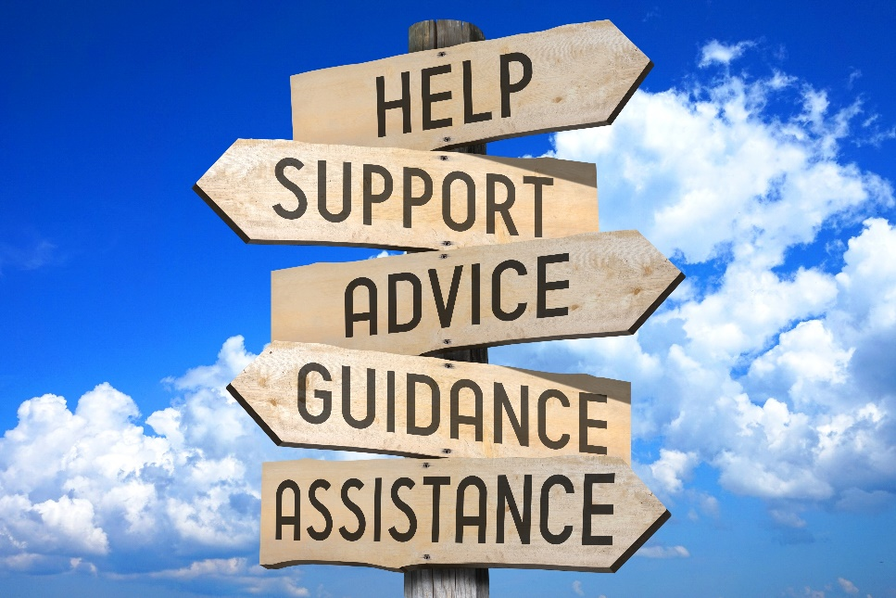
3.3 Working with complex research documents
Before you start a review
Read the guidance a couple of times before you start and keep it beside you or open on your computer while you read the research document.

Slide 23
3.3 Working with complex research documents
Before you start a review
You may find it easier to print out a hard copy of the materials. Ask if you can be sent a hard copy or if you can claim back printing costs.

Slide 24
3.3 Working with complex research documents
Before you start a review
Bear in mind that your review may contribute to the decisions made by the funding advisory committees assessing the applications. Also your comments will be passed to the researchers who have developed the proposal. (Anything in your comments that could identify you will be removed first.)

Slide 25
3.3 Working with complex research documents
Before you start a review
Set aside plenty of time and a quiet space. It is an in-depth process and takes time.

Slide 26
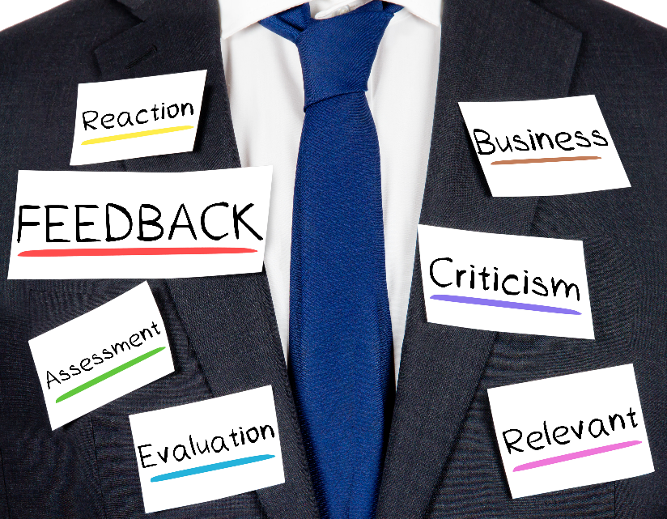
3.3 Working with complex research documents
Before you start a review
You are not expected to know everything or comment on everything. There are no wrong answers. It’s fine not to comment on particular aspects if you feel they are outside your area of experience.

Slide 27
3.3 Working with complex research documents
Before you start a review
If you don’t understand the application, particularly the plain English summary section, then the researchers are not using plain English. Please say so!

Slide 28
3.3 Working with complex research documents
During the process
You are free to comment on all areas of the research document.
To help you start you may want to read the plain English summary and the details of how the researchers plan to involve the public in the proposed study.
These give you a feel for what is being proposed and help you focus on how the researchers have included the patient and public point of view.

Slide 29
3.3 Working with complex research documents
During the process
Writing notes on the margins, underlining key points and using highlighter pens and Post-it notes can be useful. You can also do this on some computer packages such as Word.

Slide 30
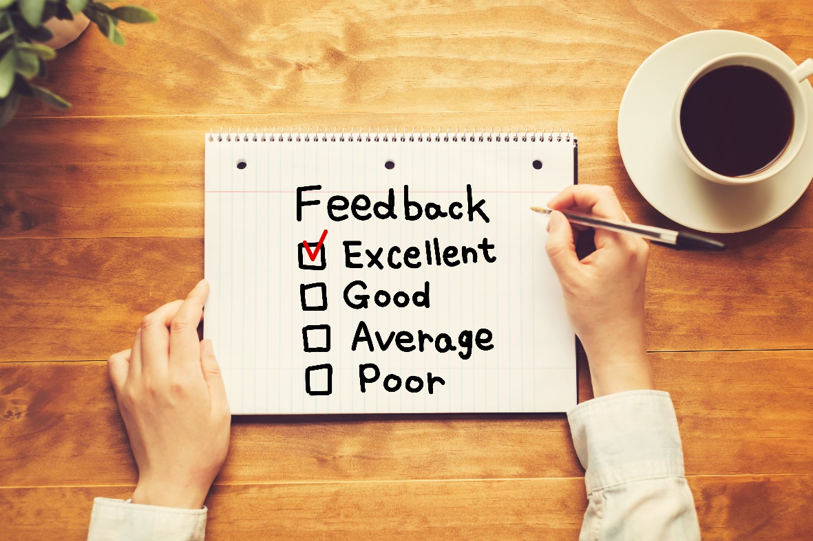
3.3 Working with complex research documents
During the process
If your document includes previous reviews and the applicants' (researchers’) responses to them, read these next.
They may highlight issues you might need to bear in mind when reading the whole document.

Slide 31
3.3 Working with complex research documents
During the process
There is a lot to read but don’t panic or feel overwhelmed at the amount of work, just allow plenty of time to read it a few times.
Take breaks to recharge and reflect on your thoughts.

Slide 32
3.3 Working with complex research documents
During the process
Ask questions of the research document such as: is the research a priority? Is it realistic? How are the public involved in the research process? How would you feel if you were asked to take part?
This is covered in more depth in module 3.

Slide 33
3.3 Working with complex research documents
During the process
If there are parts of the application or terms that you don’t understand - don’t worry. You are part of a team. Other professional reviewers will focus on these areas.
Also search online resources such as glossaries to find out more about the background and scientific terms. It gets easier over time.

Slide 34
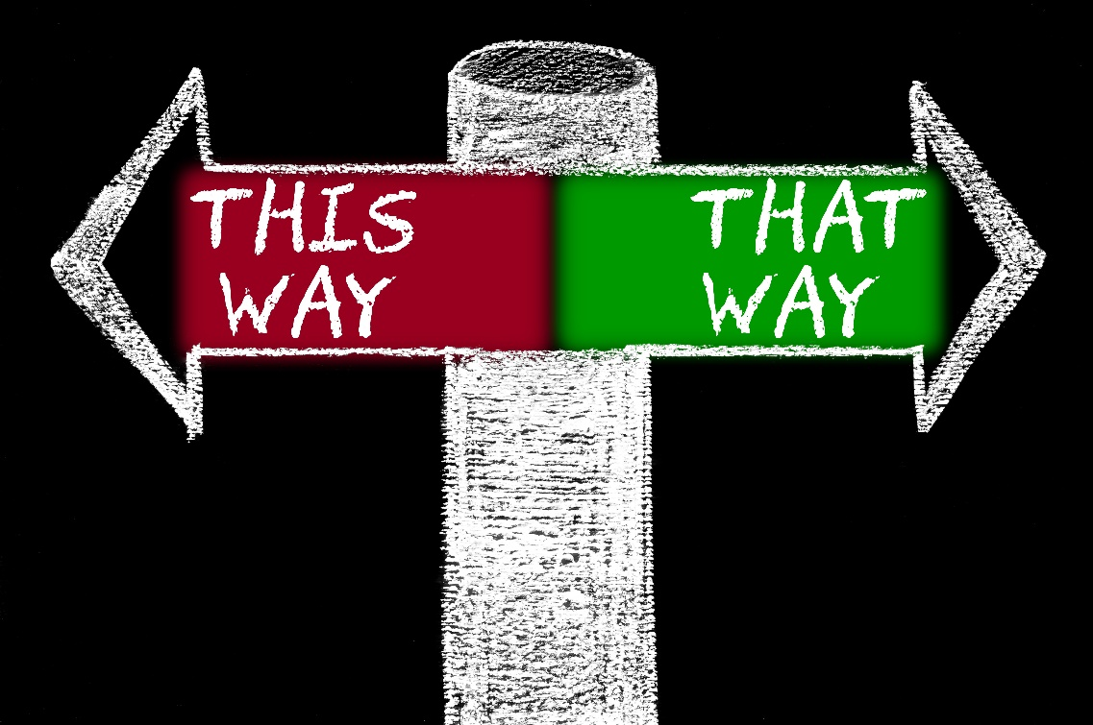
3.3 Working with complex research documents
During the process
Every reviewer has a different style and approach to reviewing the application.
There are no right or wrong ways to do it.

Slide 35
3.3 Working with complex research documents
During the process
Please give responses of more than one word.
Explain your answer - why do you think that?

Slide 36
3.3 Working with complex research documents
During the process
Be confident and constructive in the way you provide your feedback.
Positive feedback is as important as negative.

Slide 37
3.3 Working with complex research documents
During the process
Draft your responses clearly and concisely and in plain English.
Give examples if helpful.

Slide 38
3.3 Working with complex research documents
During the process
If you are writing on a computer save your work regularly!
You may also want to save it elsewhere in a Word or similar document before you copy and paste it onto the online form.

Slide 39
3.3 Working with complex research documents
During the process
Before you submit your responses, give yourself time to reflect - go back and read over your draft again.

Slide 40
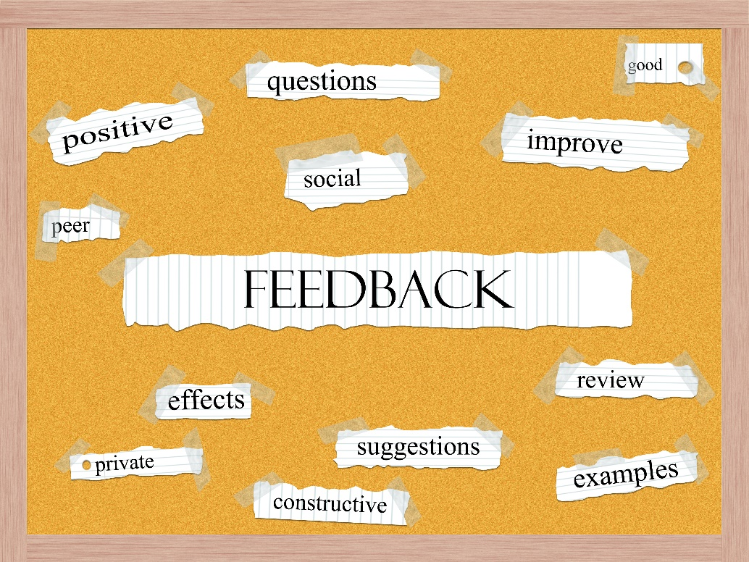
3.4 Providing constructive feedback
We may need your feedback on a structured reviewer form which you submit online. This could mean responding to questions, having a guidance document, or being asked to structure the feedback yourself. We may also ask you to give the research plan a score.
Make sure you read the guidance and provide your feedback in line with it.
Be clear, and use plain English.
Be concise and specific (stick to any word limits, don’t waffle and don't ‘story tell’ unless the story is relevant).

Slide 41
3.4 Providing constructive feedback
When you mention a strength or weakness, justify your opinion. (Why do you feel that way?)
Don't be too personal or use anything that will identify you.
Constructive feedback is both encouraging and critical, so balance your approach.
If you have ideas on how to improve the research document, say so.
Make sure the feedback can be acted on.

Slide 42
3.5 Feedback quiz
On the following pages are some examples taken from actual public reviewers’ feedback..
For each example decide whether it is a good review or not, and explain why. Click on Submit to view the suggested answer

Slide 43
3.5 Feedback quiz
a) Comments about whether you think the research asks an important question
“As a mother of children with asthma, I consider that the project reflects real issues and will test a very practical model. Attending 6 monthly reviews at a GP's can be inconvenient and time consuming. Frequently patients see different nurses or GP's - this model offers an opportunity to build up a relationship with an accessible health adviser.”
Is this a good review? (Tick): Yes No
Why? (Enter text)
Answer: This is a good review because:
The comments are based on personal experience
It highlights the importance of the issues
It gives a practical view

Slide 44
3.5 Feedback quiz
b) Comments about whether the researchers are measuring the right outcomes
“The reason women (or any patients) seek medical help is because their illness has a large impact on their daily lives, or they fear it will. This study seems to be concerned about measuring the amount of blood loss rather than the impact heavy menstrual bleeding has on the lives of the women concerned. It would be improved vastly if they also added some impact measurements such as days off work, days/time feeling ill, impact on social and family life.“
Is this a good review? (Tick): Yes No
Why? (Enter text)
Answer: This is a good review because:
It describes what is important to measure from the perspective of people affected
It clearly identifies a gap in the research application and suggests how the study could be improved

Slide 45
3.5 Feedback quiz
c) Comments about whether you think the research would work in practice
“Interviews with bereaved carers sounds like a good idea in theory, but in practice there would be a lot of challenges. It seems like the researchers don’t really understand what it’s like to be in that situation and haven’t thought about the best way to go about it.”
Is this a good review? (Tick): Yes No
Why? (Enter text)
Answer: This is not a good review because:
It mentions challenges without explaining what they might be
It criticises without offering any constructive suggestions or practical advice
The reviewer mentions their personal experience but doesn’t share anything meaningful about it

Slide 46
3.5 Feedback quiz
c) Comments about whether you think the research would work in practice
“Interviews with bereaved carers sounds like a good idea in theory, but in practice there would be a lot of challenges. It seems like the researchers don’t really understand what it’s like to be in that situation and haven’t thought about the best way to go about it.”
A better example might be:
“Interviews with bereaved carers could be an invaluable source to help understand the patient's experience, but a great deal of care will need to be taken over the timing of this discussion. If it takes place too soon after the death, the views of the carers may be significantly different to those obtained a few months later, leading to either a more positive or negative view of the patient’s care. As a carer who lived in a different area to my deceased mother, how would I have been traced to participate in the research?”

Slide 47
3.5 Feedback quiz
d) Comments about impact and dissemination
“The findings should be discussed with a group of patients to help develop recommendations for implementation (if successful) that reflect the patient experience and perspective. It might be possible to do this on an internet discussion forum on a website such as Asthma UK's.”
Is this a good review? (Tick): Yes No
Why? (Enter text)
Answer: This is a good review because:
It provides positive, practical suggestions for sharing results with patients, carers and service users.

Slide 48
3.5 Feedback quiz
e) Comments about the patient and public involvement in the proposal
“The PPI is disappointing. Simply using groups to ‘trawl’ for information is not involvement. Prostate groups in the UK are some of the most advanced male cancer groups. The skills they have in all aspects of this study are not being utilised in the best way. Simply put, a bit of consultation and a fait accompli of the finished article is not involvement. Poorly thought out and sad to see…”
Is this a good review? (Tick): Yes No
Why? (Enter text)
Answer: This is a not a good review because:
While this comment highlights the lack of PPI, it does not provide suggestions on how the research team could improve the proposed PPI.
The review should be written in plain English so it is easier for all members of the funding committee to understand. Phrases such as ‘fait accompli’ (which means something that has already been decided and cannot be changed) are not plain English

Slide 49
3.5 Feedback quiz
e) Comments about the patient and public involvement in the proposal
“The PPI is disappointing. Simply using groups to ‘trawl’ for information is not involvement. Prostate groups in the UK are some of the most advanced male cancer groups. The skills they have in all aspects of this study are not being utilised in the best way. Simply put, a bit of consultation and a fait accompli of the finished article is not involvement. Poorly thought out and sad to see…”
A better example might be:
“It is evident that the research team made efforts to engage with patients and charities initially, in order to identify important areas for research. Having agreed these, it would be good to further involve these groups as they have valuable experience to draw on. Please could the research team think about the following aspects:
Will patient groups be involved in deciding what would be manageable for participants and what their concerns might be?
Is there a specific experienced member of the research team responsible for co-ordinating, supporting and delivering patient and public involvement activities?
Would the team consider asking patients if possible to keep a brief diary (which could form part of the patient information sheet and be attached to the back), in order for them to be able to note any changes in their health or any queries that they might have while taking part? It could also be available online?”

Slide 50
4 Meeting and interview skills

Slide 51
4.1 Meeting and interview skills
Be prepared to contribute. Read the agenda, ask for a list of committee or panel members (search for their profiles online if you would like to know more about them). Ask the organisers to explain any points you don’t understand. Is there any guidance? Make notes of points you would like to raise in the meeting.

Slide 52
4.2 Meeting and interview skills
Introductions. If you or other members are new to the committee, ask to be introduced. (ask about any titles, organisations or roles that may be unclear). Be prepared to briefly say something about yourself during introductions. Also, ask that jargon and acronyms are kept to a minimum (if the Chair has not already done so).

Slide 53
4.3 Meeting and interview skills
Read all the paperwork you can, for example, protocols, commissioning or research briefs, applications and previous reviews (paying particular attention to the PPI information). What is done well and what could be done better? Prepare a couple of questions you want to ask.

Slide 54
4.4 Meeting and interview skills
Listen properly. Hear and take on board the different range of views and try to identify people’s particular interests, their knowledge and experiences. Your questions may be answered by the time you get to speak or no longer seem so relevant, but don’t worry if you are asking what you fear may be silly questions. They are unlikely to be silly and may well help alter the researchers’ attitude. Ask relevant questions, not just ones that show how much you know about PPI.

Slide 55
4.5 Meeting and interview skills
Contribute effectively. Take notes, so that you have a record of the meeting but be aware that any notes can be made public (for example, via a freedom-of-information request), Make your contribution short and clear. Remember that everyone brings value to the meeting and make sure you value everyone’s expertise. Do the organisers have specific questions they would like you to ask?

Slide 56
4.6 Meeting and interview skills
Behave professionally. Be polite and listen to others’ views. If you are interrupted while you are speaking ask the Chair if you may continue. Provide criticism constructively, smile, be interested and encourage any interviewees.

Slide 57
4.7 Meeting and interview skills
Make sure that the meeting has been summed up and that the next steps are stated and clear. Never leave a meeting unsure of what has been decided and what you are expected to do, timelines for actions and who is taking forward specific actions.

Slide 58
4.8 Meeting and interview skills
Complete any actions as promptly as you can.

Slide 59
4.9 Meeting scenarios quiz
Work through the following questions, to consider how you might apply these skills in a meeting. Click ‘Submit’ to view suggested responses.
Suggest three things you should do ahead of the meeting.
(Answers from):
Read the agenda and other paperwork.
Note any points you’d like to make or questions you have.
Find out about the other panel members.
Note the time and venue.

Slide 60
4.9 Meeting scenarios quiz
2. One of the panel members keeps using a term you don’t understand. What should you do?
Make a note of it and look it up when you get home.
Ask them to explain what they mean.
Start your contribution with, “I know that we are supposed to be keeping jargon to a miminum…”
Answer: b) It’s worth asking the question, as others might not know either. Ideally the Chair would have reminded everyone to avoid using jargon and acronyms but you can do so if not – ask directly though, don’t hint.

Slide 61
4.9 Meeting scenarios quiz
3. You’ve prepared a number of points you’d like to raise, but another person gets in first with similar suggestions. What would you do?
Go through your list of queries anyway, as it’s important to show you came prepared.
Nod to show your agreement but keep quiet, as time is limited and you don’t need to repeat what’s been covered already.
Say, “I agree with the suggestions made by…”
Answer: c) If you’ve both got the same view, it’s worth emphasising this. Non-verbal encouragement (nodding and so on) is valuable too, but it’s good to be clear.

Slide 62
4.9 Meeting scenarios quiz
4. You’ve started explaining your point when you’re interrupted by another panel member. What do you do?
Email your notes to the minute-taker at the end, and ask if they can add in your point as you didn’t get to cover it in the meeting.
Ask the Chair if you may continue speaking.
Keep talking over the other person so they realise you hadn’t finished.
Answer: b) If you feel your point is important and relevant, make sure it’s covered in the meeting.

Slide 63
4.9 Meeting scenarios quiz
5. What is the most important part of your role in the meeting?
To contribute your thoughts, based on your own background and experiences.
To make sure that PPI is considered for each agenda item.
To report back on reading you’ve done to find out more about the subject.
Answer: a) All of these are valuable, but first and foremost you are there to offer your point of view.

Slide 64
4.9 Meeting scenarios quiz
6. What do you need to do before you leave the meeting?
Answer: Check that you understand what actions have been agreed and what you need to do before the next meeting.

Slide 65
Further resources
Understanding research terminology http://www.understandinghealthresearch.org/
‘Being better informed’ module of the European Patient Ambassador Programme (EPAP) course. https://www.epaponline.org/what-is-epap/course-content/
EUPATI (European Patients Academy) glossary of health research terminology. https://www.eupati.eu/glossary/

